Slide 1
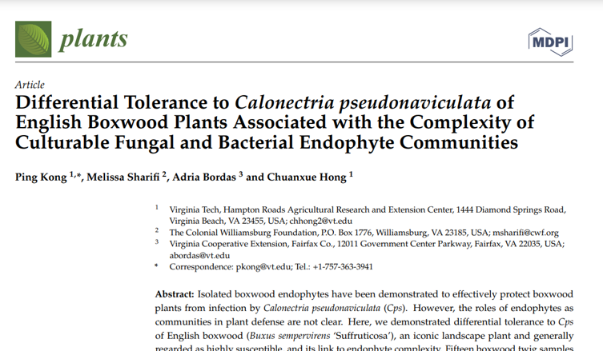
Plants 2021, 10(11), 2244; https://doi.org/10.3390/plants10112244

Slide 2
Project overview
Fungicide application impacts
Antidesiccant impacts
Location, climate, & management impacts
Irrigation impacts
Fertilizer application impacts
Boxwood age
Boxwood Phyllosphere Microbiome project
Notes:
The boxwood phyllosphere microbiome project is an ambitious move to investigate and evaluate many factors that could regulate and shape boxwood phyllosphere microbial communities. We have designed 12 component studies, and this figure just showing you that the most current and on-going sub projects I am working on, including fungicide, antidesiccant and location impacts. Today, I will brief you on the preliminary results from the fungicide impact study.

Slide 3
Preliminary report of the fungicide impacts on boxwood phyllosphere microbiome
Xiaoping Li
11/17/2021

Slide 4
Introduction
Phyllosphere microbial communities play critical role to plant growth and health
Fungicides are commonly applied to suppress plant pathogens
This may have negative effects on the beneficial microbes
This may select microbes that are capable of degrading fungicide
Notes:
The reason we are so eager to look at the phyllosphere microbiome on boxwood is that it has shown to play many important roles that relate to plant growth and health, for example, some groups living in the plant tissue can secret growth hormone to promote plant growth. However, in the agriculture production scenario, fungicides are frequently applied to suppress plant pathogens. Many studies have shown 1) it may exert negative effects on those beneficial microbes, 2) repeatedly application of fungicides may select for the microbes that can degrade the fungicide compounds. Although there are many studies that investigated fungicide effect on the boxwood blight pathogens, the knowledge of fungicide effect on the phyllophsere microbiome is still blank. Therefore, this knowledge gap encouraged us to come forward two research questions to shed lights on the issue

Slide 5
Research questions
If and how boxwood phyllosphere microbiome may be affected by fungicide applications?
If and how affected microbes may bounce back with time after fungicide treatments?

Slide 6
Study overview
Epiphytic -Surface
Endophytic
Tissue
Field experiment
Sample collection
DNA extraction
PCR amplicons
Nanopore sequencing
Bioinformatics analyses
Bacteria
Bacteria
Fungi
Fungi
Notes:
In our study, we were focusing on bacterial and fungal communities in the surface environment or epiphytes, and in the tissue environment called endophytes. To identify what microbes in those environments, we used pcr technique to amplify certain regions on the DNA that specific to bacteria and fungi, and then through sequencing and bioinformatics, to figure out their identities.

Slide 7
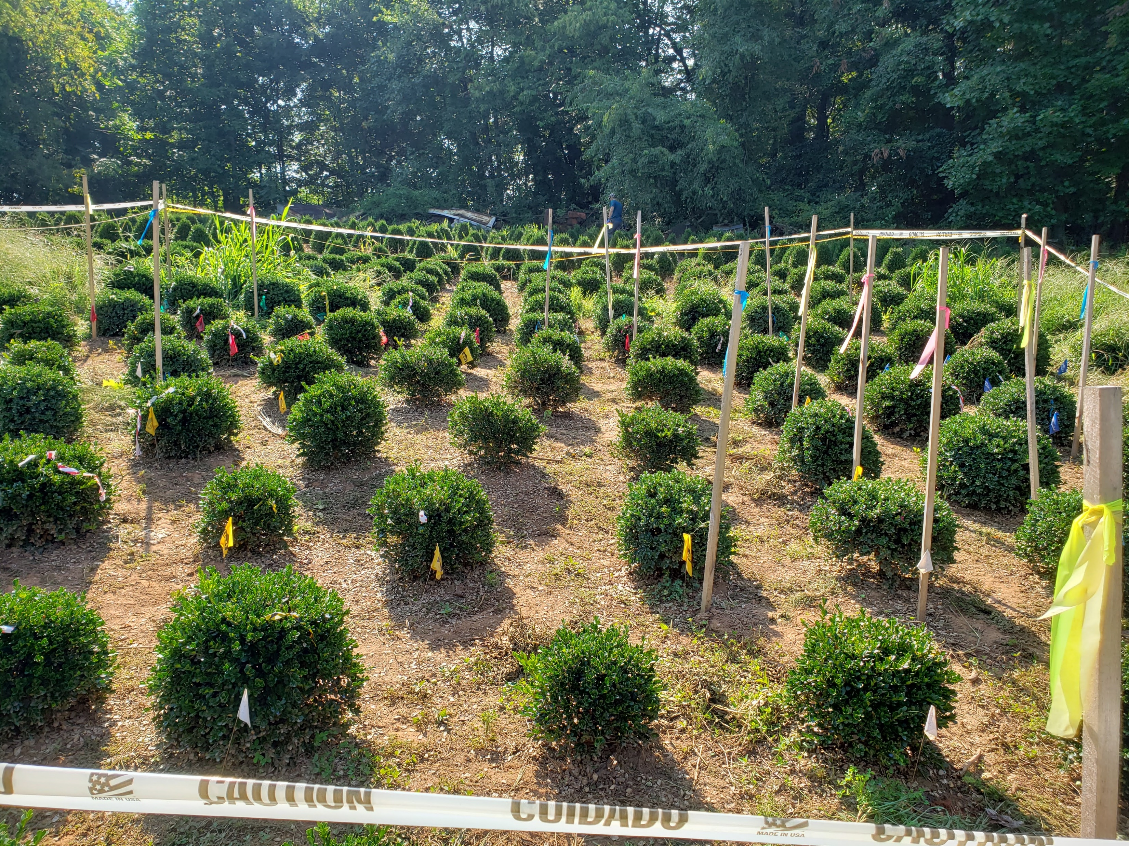
Experiment setup
 | Fungicide brand name | Active ingredient | Mobility
1 | Banner Maxx | Propiconazole (14.3%) | Systemic
2 | Daconil | Chlorothalonil (54%) | Contact
3 | Concert II | Propiconazole (2.9%)+ Chlorothalonil (38.5%) | Mixed
4 | NT (Non treatment) | NA | NA
Pre treatment
2 weeks post
1 day post
1 week post
4 blocks, one treatment and one plant in each block
Buxus semprevirens “Vardar Valley”
10 -15 twigs were collected (away from the ground)
2021
May
Notes:
We applied 3 fungicides in this study, including banner maxx, a systemic fungicide, and Daconil, a contact fungicide, and Concert II, a combination of both. Sample collection started in May, and samples were collected at four different time points: before fungicide application, one day after the application, one week after the treatment, two week after the treatment. The study site look like this, with 4 blocks and one treatment and one plant in each block. Boxwood of the study is semprevirens Vardar Valley. 10 to 15 twigs away from the ground were collected.

Slide 8
Bioinformatics
Database
NCBI bacterial complete genome
Centrifuge
Bacteria
UNITE fungal reference
Minimap2
Fungi
Notes:
Not going too detail about the bioinformatics, but we used NCBI bacteria complete genome as the database to identify bacteria and UNITE ITS fungal database to identify fungal member.

Slide 9
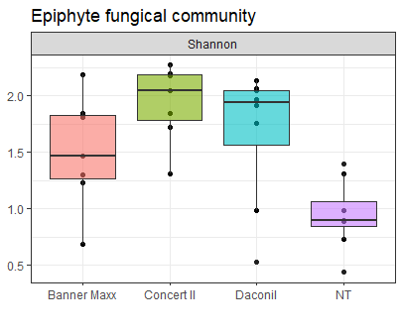
α-Diversity
 |  | F value | Pr (>F)
Epiphyte | Bacterial Comm. | 0.077 | 0.972
 | Fungal Comm. | 6.765 | 0.0016 ***
Endophyte | Bacterial Comm. | 0.839 | 0.488
 | Fungal Comm. | 1.232 | 0.323
ANOVA significant level: 5%
Notes:
alpha diversity measures how many species are there and how they are distributed within the samples. In our results, we found that fungicide impacted the alpha diversity of the epiphyte fungal community significantly. But other communities were not impacted greatly by the fungicide.

Slide 10
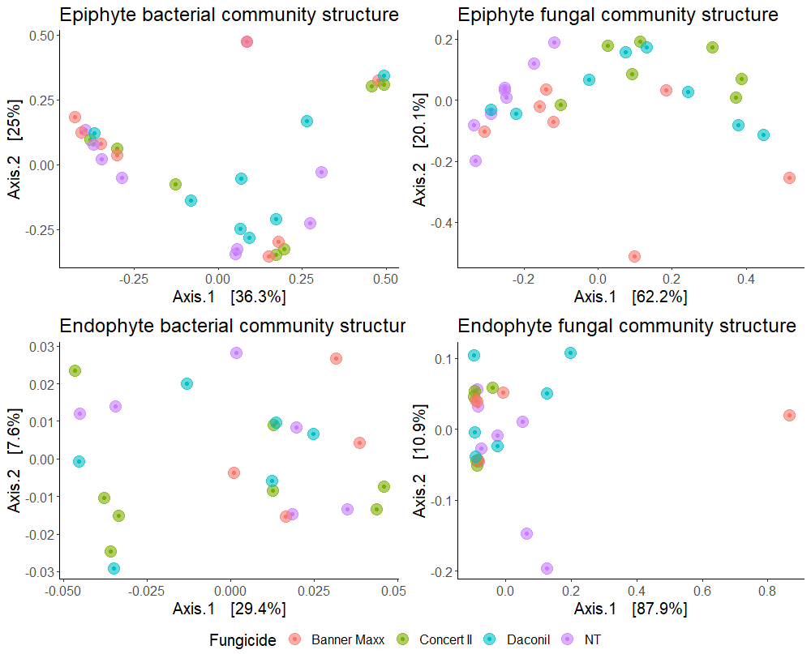
beta-diversity
 | Var. explained by fungicide | R² | Pr (>F)
Epiphyte | Bacterial Comm. | 0.099 | 0.4223
 | Fungal Comm. | 0.327 | 0.0019 **
Endophyte | Bacterial Comm. | 0.108 | 0.8039
 | Fungal Comm. | 0.123 | 0.4599
PERMANOVA 10000 permutations, significant level = 5%
Notes:
Beta diversity measures how similar are the samples based on their abundance. Similarly, fungicide impacted epiphyte fungal community beta diversity greatly but not others.

Slide 11
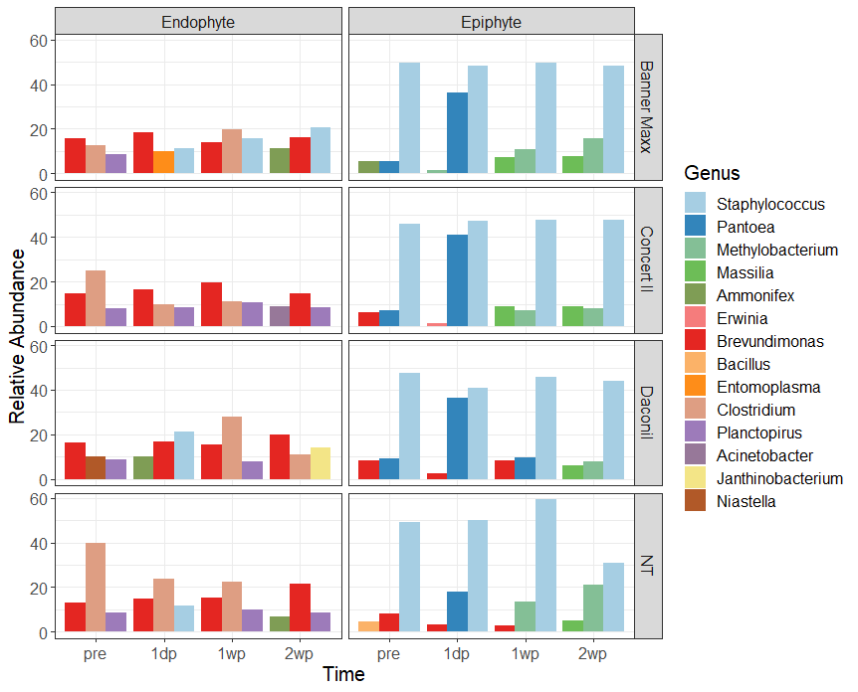
Most abundant Bacteria
Top abundant genera differed between the two environments
Staphylococcus (epi)
Clostridium (endo)
Brevundimonas (endo)
Pantoea (epi) more responded to fungicide very quick but decreased after 1 week
Clostridium (endo) reacted differently to the fungicides

Slide 12
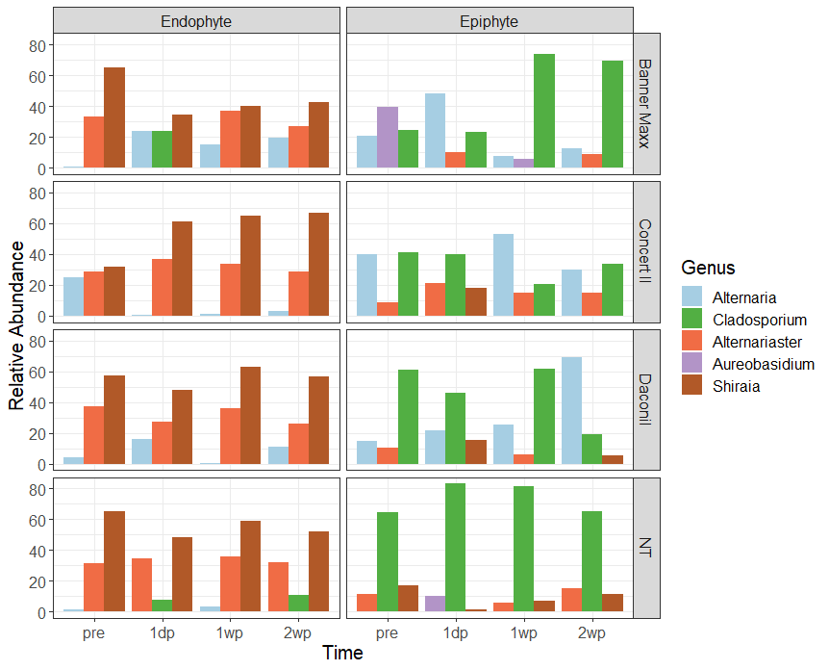
Most abundant Fungi
Top abundant genera differed between two environment
Cladosporium (epi)
Alternaria (epi)
Shiraia (endo)
Alternariaster (endo)
Alternaria(epi) enriched in the treatments, also reacted differently
Alternaria (endo) reacted differently to the fungicides, suppression in Concert II but enriched in Banner Maxx

Slide 13
Summary
Epiphyte fungal community diversity and structure were affected significantly by fungicides
The abundance of epiphytic fungal members appeared responded to the fungicides more than endophytic ones
Alternaria (epi) is more abundant in the fungicide treatment
Alternaria (endo) enriched in Banner Maxx but suppressed by Concert II
Bacterial community remained consistent in both the epiphytic and endophytic environments
Pantoea (epi) seems more sensitive to the fungicide, but decreased after 1 week
Notes:
Several Alternaria spp are plant pathogens causing leaf blight, and some epiphyte alternaria are saprophytes that are capable of decaying organic matter may be also able to utilize that in the fungicide.
Pantoae species has shown have bioremediation potential ( ability to degrade herbicides), they also have biological control function by producing antibiotics. This deserves more of our attention in the future study.
These preliminary data suggest that fungicides do have different impacts on the boxwood phyllosphere microbiome, more details of how the microbial communities responded would be revealed with more analyses in different angles. And the completion of our fall sample sequencing.

Slide 14
Acknowledgement
This work was done in collaboration with colleagues of North Carolina Department of Agriculture and Consumer Services and NC Cooperative Extension

Slide 15
Thank you and Questions !

Slide 16
Database comparison
 | NCBI whole genome (Centrifgue) | SILVA (inhosue curated) | UNITE (inhouse curated)
Bacteria | 1,144,436 | 438,119 | NA
Fungi | 187 | NA | 43,677

Slide 17
Sequence summary
 | RUN1 | RUN1 |  | RUN2 | RUN2
 | Total (mil) | 16S | ITS | Total (mil) | 16S | ITS
Epiphytes | 8.33 | 60,756 | 205,558 | 5.5 | 53,950 | 158,937
Endophytes | 1.32 | 24,745 | 18,324 | 2.49 | 60,884 | 38,753
Q >= 9
Length 1kb – 2kb

